Slide 1

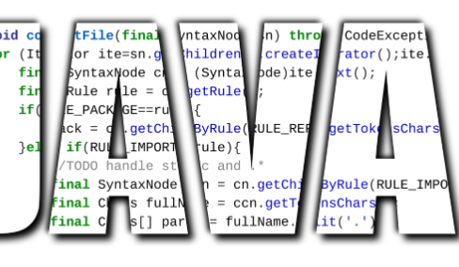
Introduction to Java
JAVA

Slide 2
Introduction to Java
Language Characteristics
Syntax – easy Syntax
Strongly typed
Pure OOP
Size Of primitives is laid down
Garbage Collector
Multithreading Language
Support Exceptions
Java

Slide 3
Introduction to Java
Java Does NOT Have
Memory address (pointers) arithmetic
Preprocessor
Automatic type conversion
Global functions and variables
Typedefs
Operator overloading
Multiple inheritance
Java

Slide 4
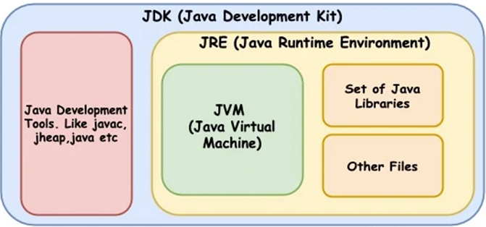
Introduction to Java
JDK
Java

Slide 5
Introduction to Java
Program Development steps
Write – The programmer is writing the code as text, using the programming language keywords and syntax.
Compile – Using a compiler program, the code is converted from text form to binary form so machines can run it.
Run – Executing the program.
Java

Slide 6
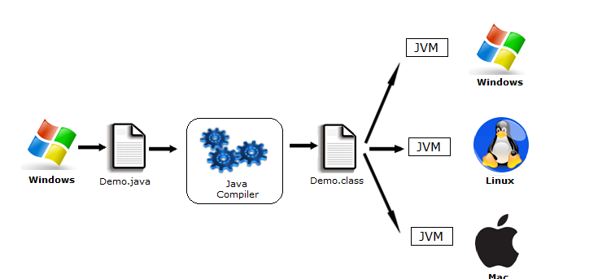
Introduction to Java
Portability
Java

Slide 7
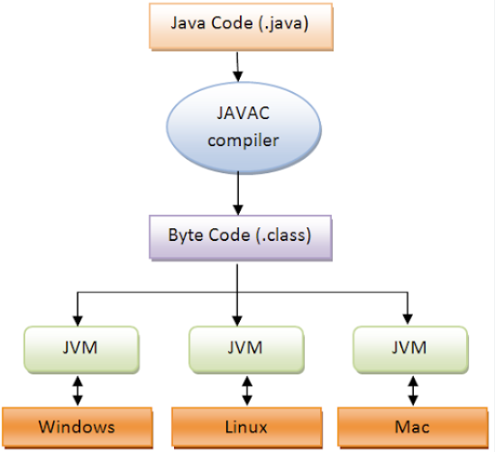
Introduction to Java
Portability
Java

Slide 8
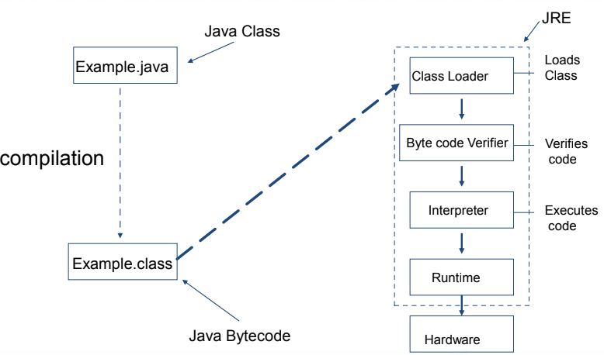
Introduction to Java
JRE
Java

Slide 9
Introduction to Java
JRE
Class Loader - Loads all classes which are necessary for the execution of a program
Bytecode Verifier – verifies that class bytecode is legal and does not violate system integrity
Interpreter/JIT Compiler – Executes the code
Java

Slide 10
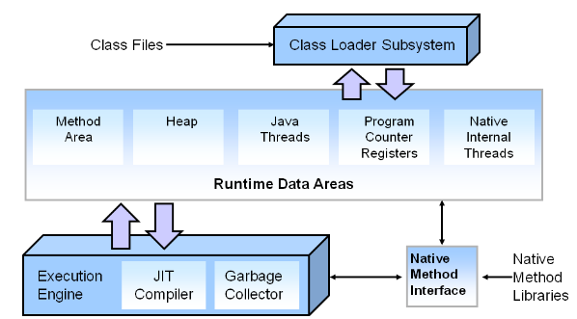
Introduction to Java
JVM
Java

Slide 11
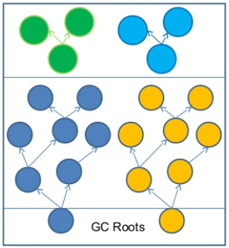
Introduction to Java
GC
The garbage collector frees all dynamically allocated memory that is no longer referenced
An object located on the heap that is no longer referenced
should be regarded as “garbage” and has to be removed
Garbage collection is actually memory recycling
Java

Slide 12
Introduction to Java
Java APIs
Java runtime JFC
Security JDBC
JavaBeans Java RMI
Java Communications JavaMail
Java media JNDI
Java

Slide 13
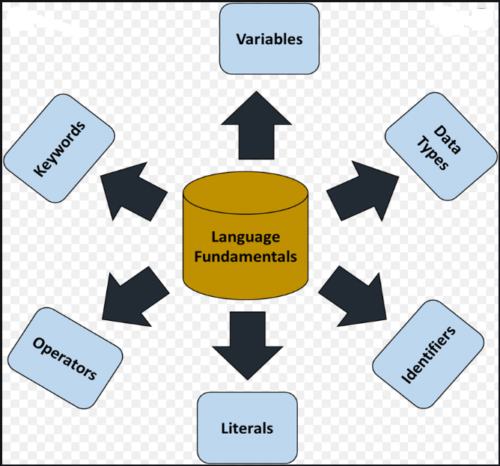
Introduction to Java
Fundamentals
Java

Slide 14
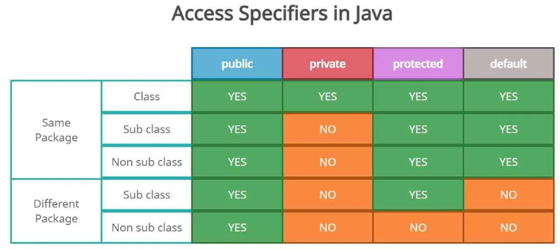
Introduction to Java
Modifiers
Java

Slide 15
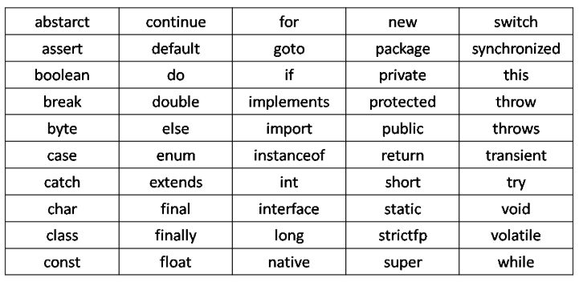
Introduction to Java
Keywords
Java

Slide 16
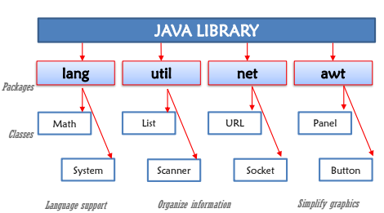
Introduction to Java
JAVA LIBS
Java

Slide 17
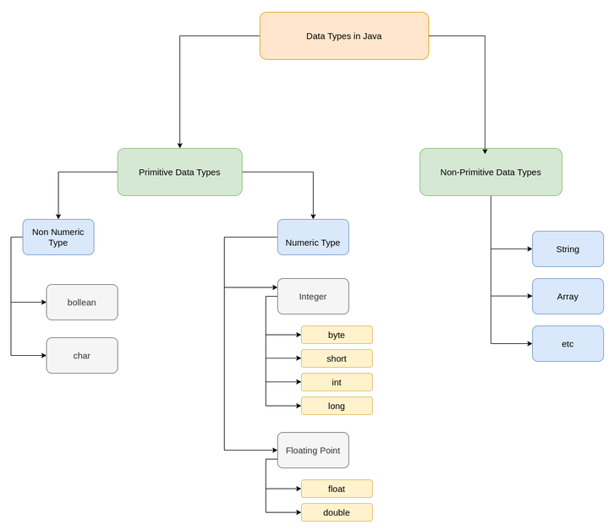
Introduction to Java
Data Types
Java

Slide 18
Introduction to Java
Components
Class : A blueprint source code for instantiating objects
Object : An instance of a class
Attribute : (Class Data Member, Data Field)
Method : (Class Function) A behavioral element of a class
Constructor : A method that is called whenever an object of class is instantiated.
Package : A grouping of classes (directory)
Java

Slide 19
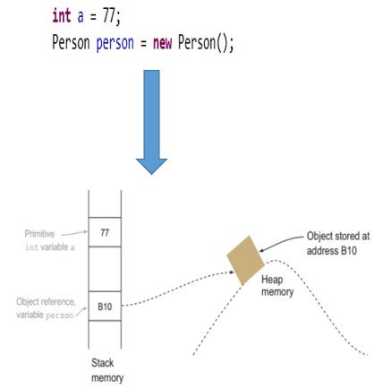
Introduction to Java
Memory
Java

Slide 20
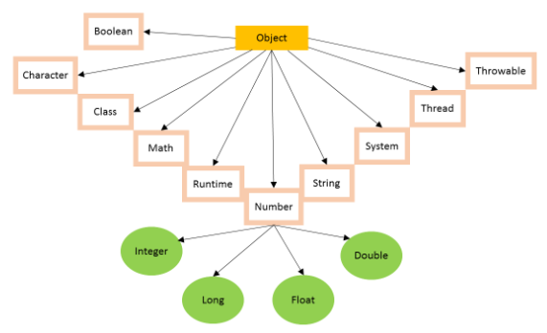
Introduction to Java
Object Class
Java
Object class is present in java.lang package.
Every class in Java is directly or indirectly derived from the Object class.
Object class methods are available to all Java classes.
Object class acts as a root of the inheritance hierarchy in any Java Program.

Slide 21
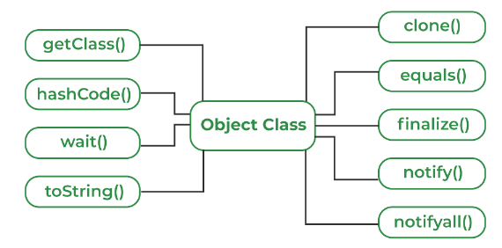
Introduction to Java
Object Class
The Object class provides multiple methods which are as follows:
toString() method
hashCode() method
equals(Object obj) method
finalize() method
getClass() method
clone() method
wait(), notify() notifyAll() methods
Java

Slide 22
Introduction to Java
Java
Thank You !!

